Slide 1
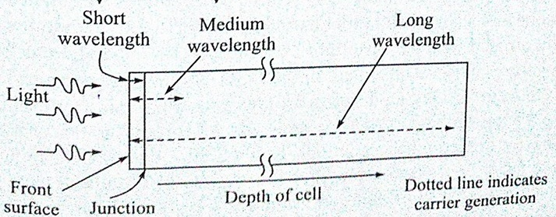
Quantum Efficiency
Probability of a incident photon resulting in generation and collection of an electron
Quantum Efficiency Measurement parameters
Solar cell performance for diff λ
Material quality
( diffusion length and carrier life time), surface recombination
Quality of cell fabrication/texture/passivation

Slide 2
.If all photons of a certain wavelength are absorbed and the resulting minority carriers are collected, then the QE is unity or 100%.
The quantum efficiency for photons with energy below the band gap is zero
Photon of different λ absorbed at different depth
Generation and collection of charge career before recombination in QE curve
High energy blue photon absorbed near to surface (100nm)
Mid λ green need few micron and Long wavelength red photon need few hundred micrometer.
QE for different λ gives info about different region
High QE for blue show high generation and collection of electron due to blue photon near the junction
Low QE for red shows, electron generated away from junction and high recombination

Slide 3
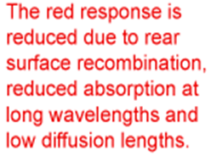
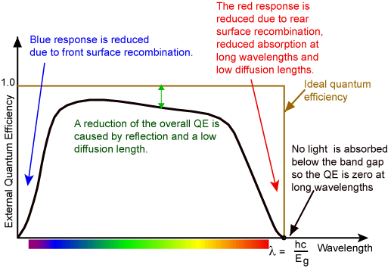

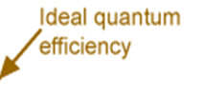
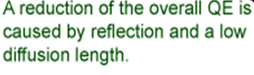
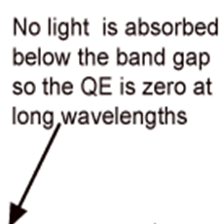

Slide 4
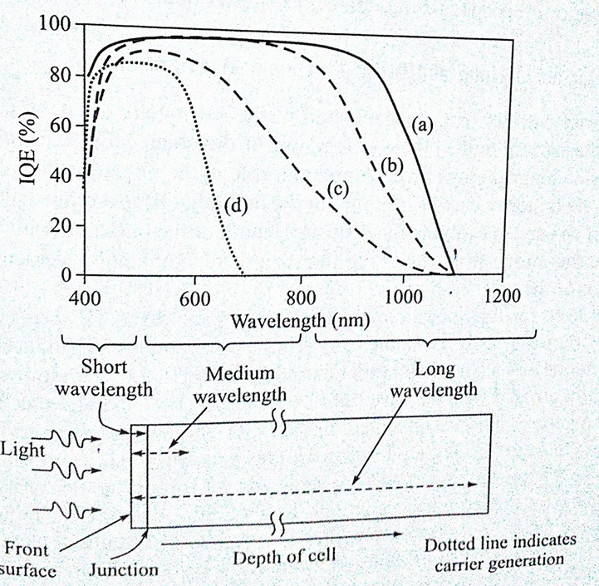
Cell a:
High QE for blue: front surface well passivated
High QE for green and red:
Junction is good , back surface recombination is low, High diffusion length,
QE is zero at 1100nm gives band gap
Cell b:
Material quality is good
Low QE in blue and red region : passivation is not good at front/back
Cell c:
Neither material nor passivation is good
Cell d:
High band gap (1.75ev) as QE is zero at 700nm

Slide 5
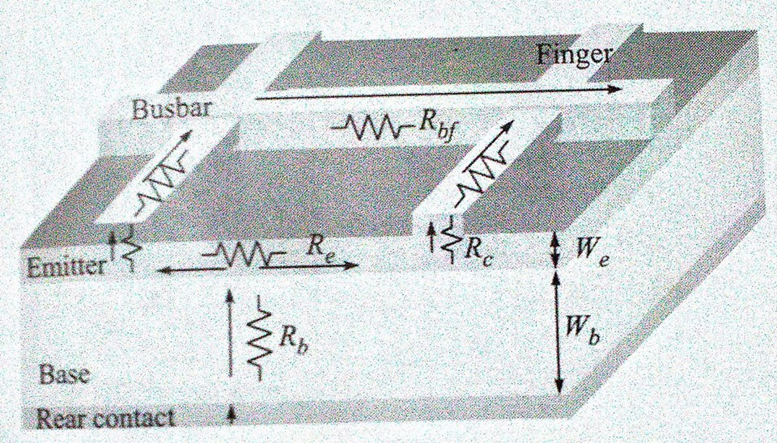
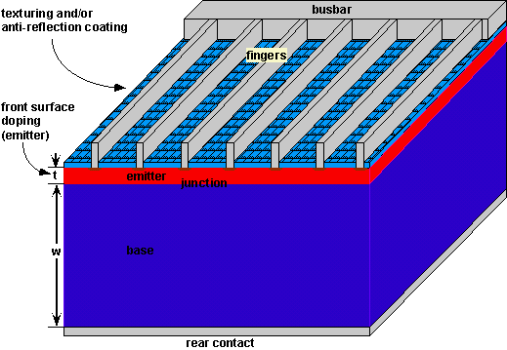
Metal Grid Pattern
The design of the top contact involves not only the minimization of the finger and busbar resistance, but the overall reduction of losses associated with the top contact.
These include resistive losses in the emitter, resistive losses in the metal top contact and shading losses.
The critical features:
the finger and busbar spacing,
the metal height-to-width aspect ratio,
the minimum metal line width and
the resistivity of the metal.

Slide 6
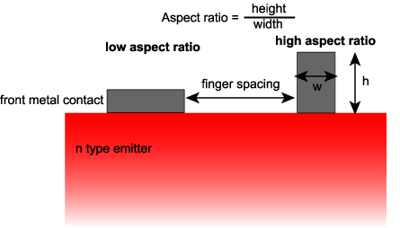
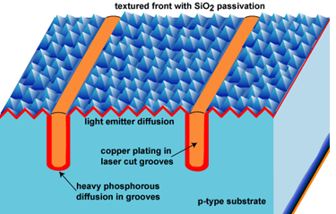
Buried contacts. Differential n⁺ doping in the contact grooves reduces series resistance.

Slide 7
Impact of Finger Spacing on Emitter Resistance
An important factor in top contact design is that of resistive losses in the emitter. As discussed in the Emitter Resistance section:
the power loss from the emitter depends on the cube of the line spacing, and
therefore a short distance between the fingers is desirable for a low emitter resistance.
Grid Resistance
The grid resistance is determined by:
the resistivity of the metal used to make the metal contact,
the pattern of the metallization and
on the aspect ratio of the metallization scheme.
A low resistivity and a high metal height-to-width aspect ratio are desirable in solar cells, but in practice are limited by the fabrication technology used to make the solar cell.

Slide 8
Shading Losses
Shading losses are caused by the presence of metal on the top surface of the solar cell which prevents light from entering the solar cell.
The shading losses are determined by the transparency of the top surface, which, for a planar top surface, is defined as the fraction of the top surface covered by metal.
The transparency is determined by the width of the metal lines on the surface and on the spacing of the metal lines.
An important practical limitation is the minimum line width associated with a particular metallization technology. For identical transparencies, a narrow line-width technology can have closer finger spacing, thus reducing the emitter resistance losses.

Slide 9
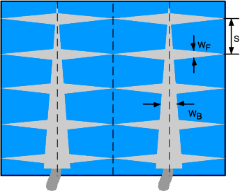
Design Rules
While a multitude of top contacting schemes exist, for practical reasons most top surface metalization patterns are relatively simple and highly symmetrical. A symmetrical contacting scheme can be broken down into unit cells and several broad design rules can be determined. It can be shown that:
the optimum width of the busbar, W_{B}, occurs when the resistive loss in the busbar equals its shadowing loss;
a tapered busbar has lower losses than a busbar of constant width; and
the smaller the unit cell, the smaller finger width, W_{F} , and the smaller the finger spacings, S, the lower the losses.
Schematic of a top contact design showing busbars and fingers

Slide 10
Optimization of Finger Spacing
Combining the equations for resistive losses allows use to determine the total power loss in the top contact grid.
For a typical cell type, say a screen printed cell, the metal resistivity will be fixed and the finger width is controlled by the screen size.
Typical values for the specific resistivity of silver are 3 × 10⁻⁸ Ω m.
For non-rectangular fingers the width is set to the actual width and an equivalent height is used to get the correct cross sectional area.

Slide 11
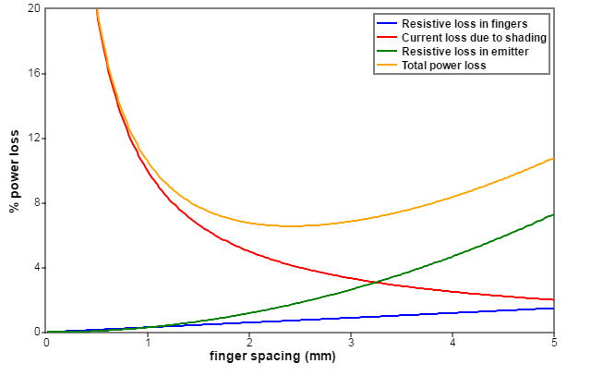
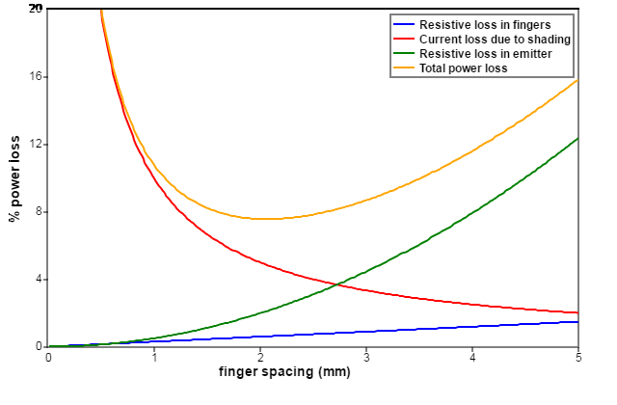
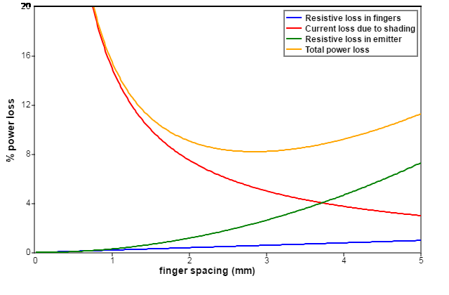
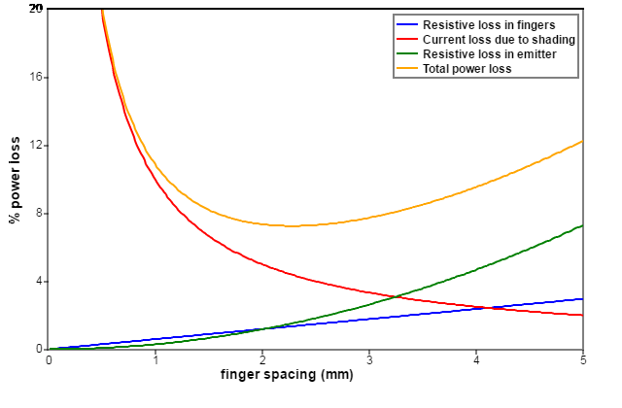
Finger Length: 39 mm, Emitter Sheet resistivity: 60 Ω per sqr,
Finger Width: 100 microns , Finger depth: 30 microns
Total. Pmin = 6.56%, Sfmin = 2.42 mm, Rs= 0.41 Ω cm²
Finger Length: 39 mm, Emitter Sheet resistivity: 100 Ω per sqr,
Finger Width: 100 microns , Finger depth: 30 microns
Total. Pmin = 7.56%, Sfmin = 2.07 mm, Rs= 0.47 Ω cm²
Finger Length: 39 mm, Emitter Sheet resistivity: 60 Ω per sqr,
Finger Width: 150microns , Finger depth: 30 microns
Total. Pmin = 8.2%, Sfmin = 2.85 mm, Rs= 0.5 Ω cm²
Finger Length: 39 mm, Emitter Sheet resistivity: 60 Ω per sqr,
Finger Width: 100 microns , Finger depth: 30 microns
Metal resistiviti double: 3 to 6 micro ohm/cm
Total. Pmin = 7.25%, Sfmin = 2.28 mm, Rs= 0.49 Ω cm

Slide 12
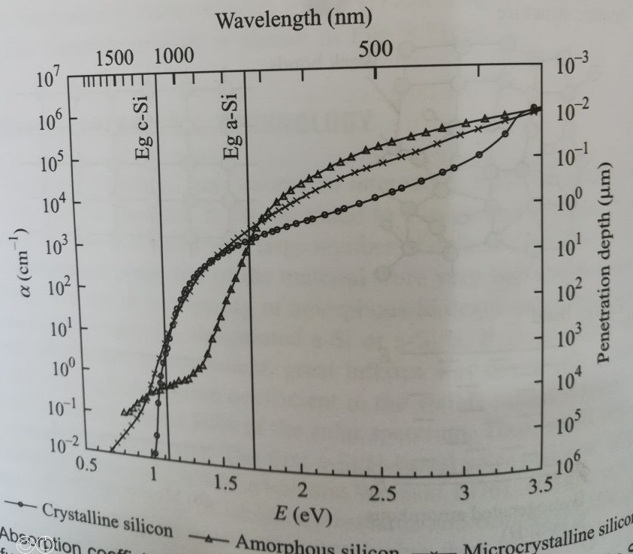
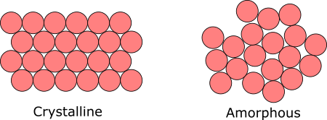
Thickness of Cell
Minimum thickness of A-Si cell for 2.5 eV energy photon????

Slide 13
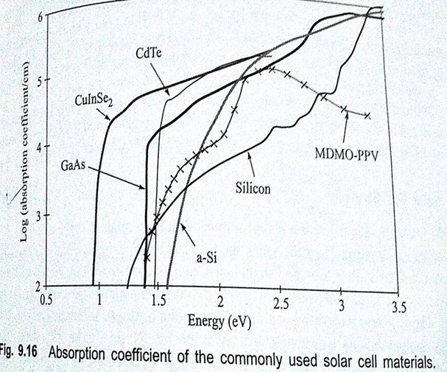
Cadmium Telluride (CdTe)Cell:
Key material properties: Bond energy 5.75
CdTe: binary compound semiconductor :II-VI semiconductor
Cd: group II and Te: group VI
Optical properties:
Direct band gap
High absorption coefficient
Band gap 1.5 eV ideal for
high efficiency for single junction cell
Band gap of a-si is higher and lower
for C-Si for ideal gap of high eff.
for 1.5eV, it doesn’t absorb 850nm,
but absorb all visible light
ab. Coeff is high 10⁴/cm, only small
thickness is required
max thickness to ab all light: 1 micro m.
Bond energy of CdTe: 5.75 eV
very stable, Doesn’t degrade like a-Si
High Radiation resistance due to high bond energy
suitable for space application

Slide 14
Cadmium Telluride (CdTe)Cell:
Key material properties:
properties:
Due to low thickness: less distance to travel to reach junction
Minority charge diff. length 1 μm sufficient
Quality of material:
With low abs length and low diff length, poor quality material can be used
Grain size of the material ≈ thickness
Grain boundaries of CdTe are electrically inactive :
no grain boundary recombination even without passivation
CdTe a stable compound
Can not be alloyed with other material like a-Si and CuLnSe2
Band gap can not be altered and can not be heavily dopped
CdTe acts as a p type semicounductor
For n type: CdS is the common choice of band gap 2.5 eV
Absorb only up to 500nm photon leaving all the visible light for CdTe

Slide 15
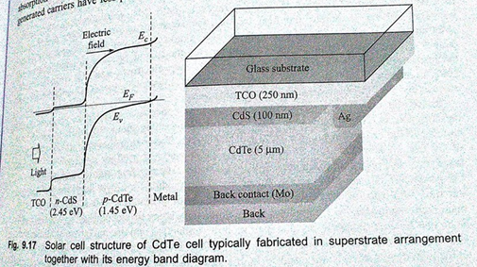
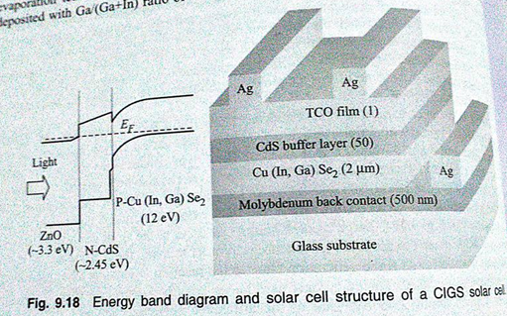

Slide 16
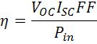
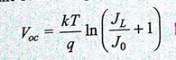
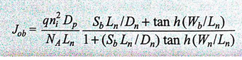
Efficiency: thin film vs bulk Si solar cell
theoritical efficiency of thin film is higher…???
Volume of recombination loss decreases as device volume/thickness low
Absoption of light is high with proper light trapping
Increase in eff with decrease the thickness is due to lower saturateion current J0,
which increase the Voc , as J0 is the sum of J0e and Job

Slide 17
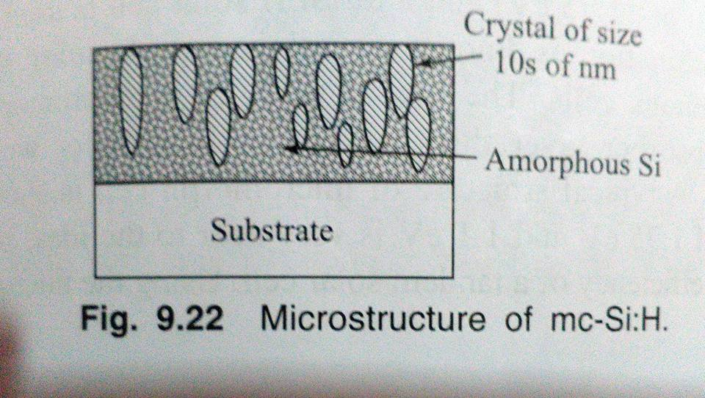
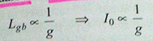
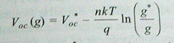
Grain size and Efficiency:
size could be few nano (micro-crystalline Si) to infinity (monocrystalline Si)
efficiency again depends on grain size through Voc
for microcrystalline grain size doesn’t have any effect on Voc
for polycrystallie Voc depends on grain size
Smaller grain size have large garin boundary area
Recombination is large with small grain size
Higher saturation current I0
* Characteristic Voc and grain size

Slide 18
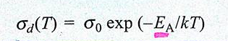
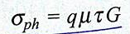
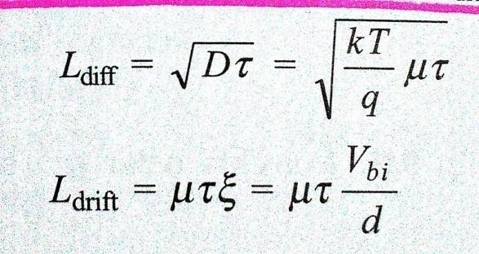
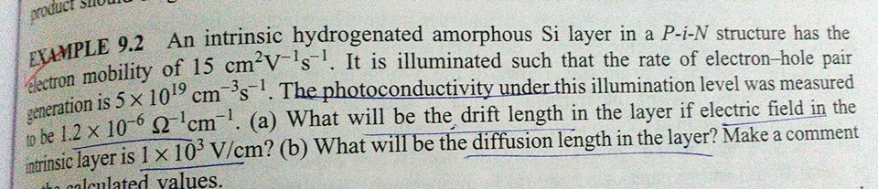
Electrical properties:
Conductivity: dark conductivity
photo conductivity
mobility due to drift
mobility due to diffusion
in poor quality material or thin film where
diffusion length is very small
so low mobility and low carrier life time
Mobility of charge carrier can be increased by increasing
carrier transport length using drift instead of diffusion

Slide 19
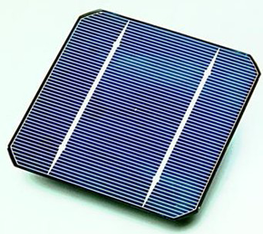
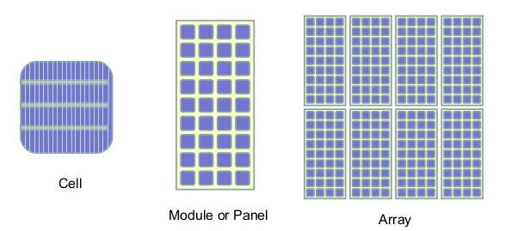
Solar PV Module and array:
For singe cell: Power out put : efficiency of cell
P = 10-25 mW/cm2 for 10-25% effeiciency
Area of cell: 15x15 cm2 with 15 % efficiency
Wp = 3.37 W max
For less efficient and small size
Wp = 0.25W
Too small for terrestrial application/house hold appliances/water pump/solar plant
For ex: 15x15 cm2 cell:
Voc 0.6V and Isc= 0.8 A.
P=0.48W
For four times Pout????
Or
Increase power out???

Slide 20
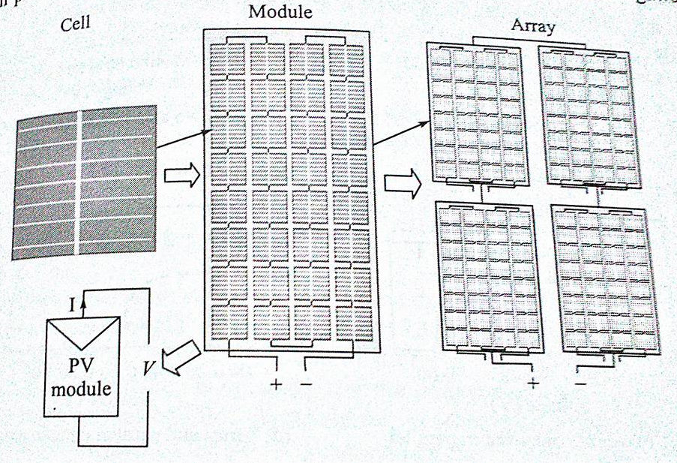

Slide 21
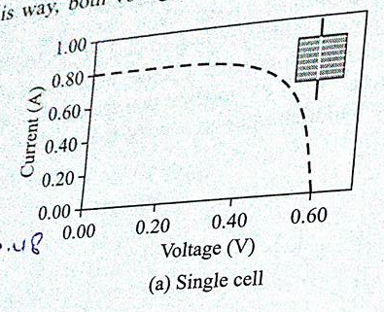
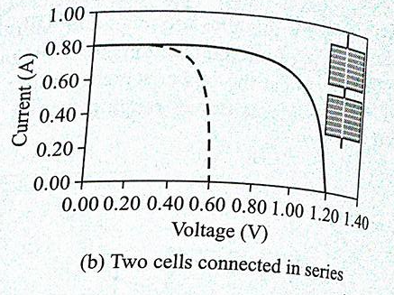
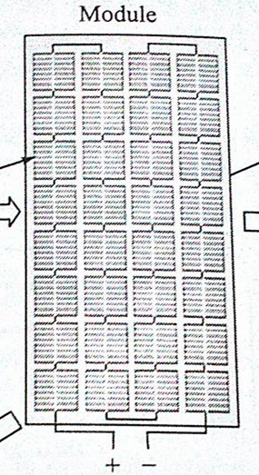
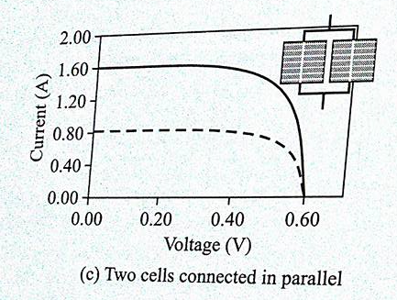
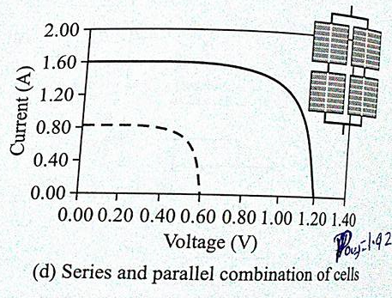
For ex: 15x15 cm2 cell: Voc 0.6V and Isc= 0.8 A, P=0.48W
2 cells in a series:
2 cells connected parallel :
To twice the Ics and Voc???
P=1.92W
In a typical PV module 36 cells are connected in series, giving 36 times Voc at Isc of single cell
Why 36 cell in series???
Notes:
A bulk silicon PV module consists of multiple individual solar cells connected, nearly always in series, to increase the power and voltage above that from a single solar cell. The voltage of a PV module is usually chosen to be compatible with a 12V battery. An individual silicon solar cell has a voltage of just under 0.6V under 25 °C and AM1.5 illumination. Taking into account an expected reduction in PV module voltage due to temperature and the fact that a battery may require voltages of 15V or more to charge, most modules contain 36 solar cells in series. This gives an open-circuit voltage of about 21V under standard test conditions, and an operating voltage at maximum power and operating temperature of about 17 or 18V. The remaining excess voltage is included to account for voltage drops caused by other elements of the PV system, including operation away from maximum power point and reductions in light intensity.

Slide 22
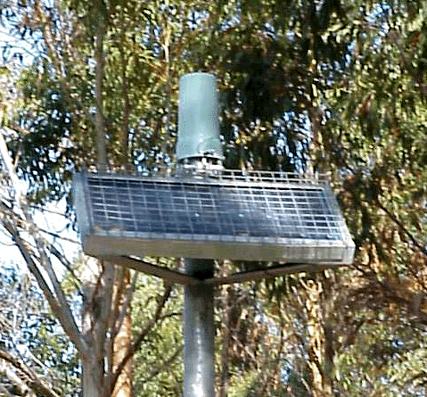
Mismatch in cell/module:
For max power output from module and array,
cells connected in series or parallel
should be identical in term of electrical parameters
Identical in terms of optical parameters
Some differences due to:
difference in cell processing
different out side condition/shading
semi transparent for exposure over the time
breaking glass/damage/ATR film
Any non-identical cell/module/condition:
best case:
loss in output power
worst case:
severe physical damage to module
Most common mismatch due to electrical parameters:
mismatch due to Voc or Isc
mismatch is very common in series and also increases due to shading exposure

Slide 23
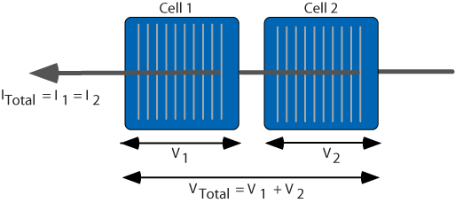
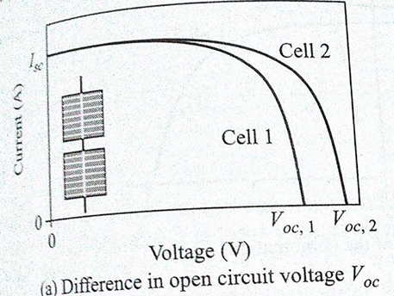
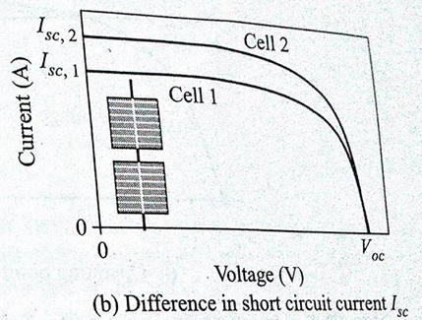
Mismatch for Cells Connected in series:
In which case Power loss ????
Difference b/w Voc ????
Cells operating near open circuit mode:
output voltage of combination: sum of two
Isc same for both: same current flow
power output: sum of two
no power loss
Difference b/w Isc….????
Cells operating in short circuit mode:
output voltage of combination: sum of two
max current in the combination is limited
by the cell of lower Isc
max power output: limited by lower current
power loss

Slide 24
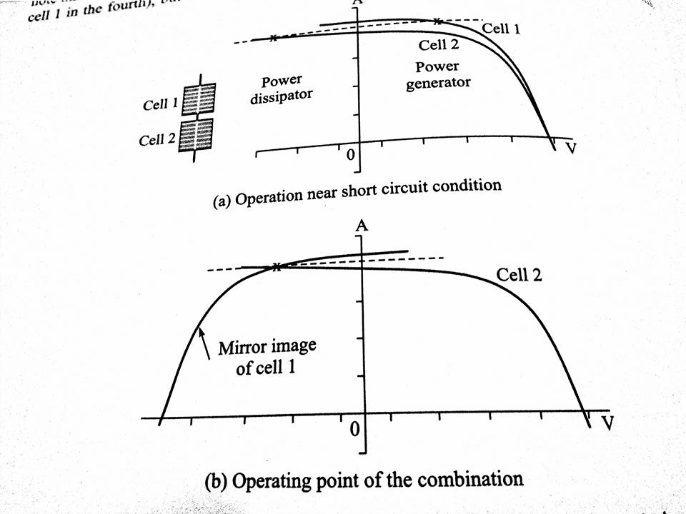
Mismatch for Cells Connected in series:
Cells operating in near short circuit mode:
Current in both cell should be same
Extra current generating power of good cell…???
dissipate into the poor cell
Good cell force bad cell to pass more current that bad cell current
Only possible when bad cell operate in negative voltage
bad cell of lower Isc is forced to go in
reverse bias condition, to maintain the same
current in two cells
in reverse bias situation, the forward bias current
of bad cell decreases which increase its
effective current (I_{L} – I_{f})
as it works in reverse bias, it dissipates
rather than generating power
in this total voltage of two cells become zero
Notes:
A mismatch in the short-circuit current of series connected solar cells can, depending on the operating point of the module and the degree of mismatch, have a drastic impact on the PV module. As shown in the animation below, at open-circuit voltage, the impact of a reduced short-circuit current is relatively minor. There is a minor change in the open-circuit voltage due to the logarithmic dependance of open-circuit voltage on short-circuit current. However, as the current through the two cells must be the same, the overall current from the combination cannot exceed that of the poor cell. Therefore, the current from the combination cannot exceed the short-circuit current of the poor cell. At low voltages where this condition is likely to occur, the extra current-generating capability of the good cells is not dissipated in each individual cell (as would normally occur at short circuit), but instead is dissipated in the poor cell.
Overall, in a series connected configuration with current mismatch, severe power reductions are experienced if the poor cell produces less current than the maximum power current of the good cells and also if the combination is operated at short circuit or low voltages, the high power dissipation in the poor cell can cause irreversible damage to the module. These effects are illustrated in the two animations below.

Slide 25
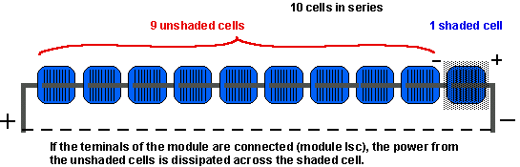
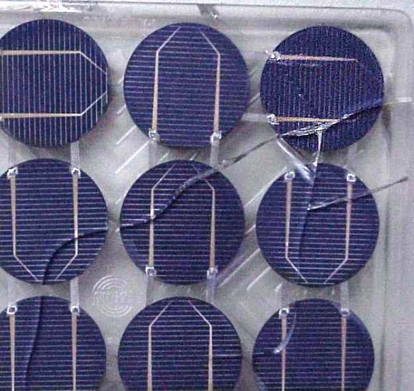
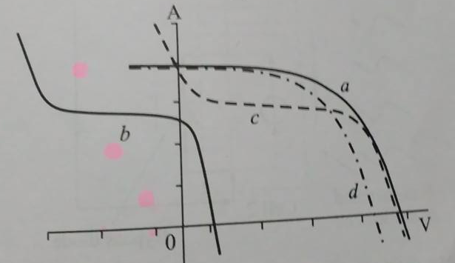
Hot Spot in the module:
Under the short circuit condition
The shaded cell will become reverse biased
All the forwarded biased voltage of unshaded cells
Appear across the shaded cell
due to this strong reverse biased voltage
complete breakdown of cell
or can generate heat locally and forming hot spot
Extra power generated by non shaded cells dissipated in to shaded
Cell, resulting in hot spot.
This hot region can breaking cell, detachment the metal contact
Breaking glass, damage anti ref coating….
To avoid Hot Spot or local heating….????

Slide 26
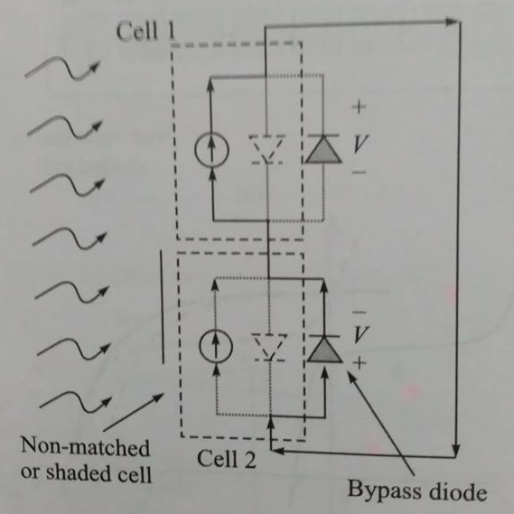
By pass Diode:
By pass diode to avoid destructive effect of hot spot
Diode connected in parallel with solar cell but
with opposite polarity
For unshaded (normal solar cell) by pass diode work
in reverse bias: open circuited
For shaded cell, as the cell is working in reverse bias,
by pass diode will work in forward bias
Extra current generated by un shaded cell will pass
through this diode, avoiding power dissipation
and heat generation
Bypass diodes allow current to pass around shaded cells and thereby reduce
the voltage losses through the module
supplying power at a reduced voltage rather than no power at all

Slide 27
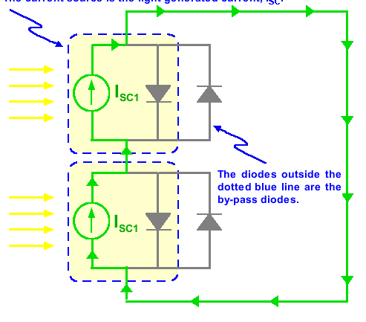
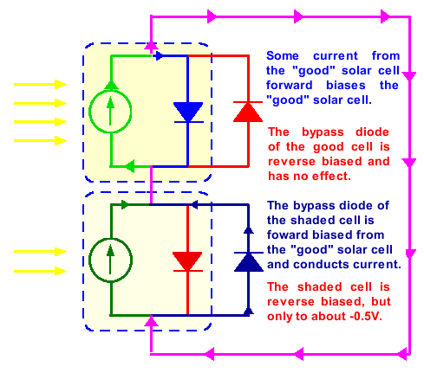
Short circuit condition
Effect of bi-pass diode on Voc:
in un shaded case: for N solar cells
V = N Voc
With shaded solar cell
V’=(N-1)Voc – Vfb
Vfb= forwarded bias voltage of bypass diode
Ideally one bi-pass diode with one solar cell in module, but to reduce cost now a days,
2-3 bypass diodes for 36 solar cells in series in a module

Slide 28


Short circuit condition
open circuit condition

Slide 29


Slide 30


Miss match in parallel

Slide 31




PV module power output:
I-V equation of PV module:
Same as of single solar cell
I-V curve : combination of all cells
For single solar cell:
I_{L}: light generated current
I₀: reverse bias current
R_{s}: series resistance
K=nkT/q
For module:
n cells connected in series
I_{Lmo}: light generated current=I_{L}
I_{0m0}: reverse bias current=Io
R_{smo}: series resistance=NsRs

Slide 32


Ns cells connected in series
in a module:
Np cells connected parallel
in a module/array:
For large PV application:
Modules connected parallel:
cells connected in series and parallel combination:

Slide 33



Slide 34





Rating of a PV module:
in terms of peak power (Wp)
Standard Test Conditions (STC):
Standard Operating Conditions (SOC):
Nominal Operating Cell Temperature (NOCT):
T_{mod} = T_{amb} + K P_{in}
Effect of temp:

Slide 35




Slide 36
Design of Solar PV System
Regulated Stand Alone System with Battery and AC Load

Slide 37
Solar PV systems
Introduction to solar PV system
Types of solar PV system
Stand Alone
Grid connected
Hybrid
Design of a stand alone solar PV system

Slide 38

Solar PV systems
All PV systems consist of one or more modules (arrays) which produce DC power
Solar PV system is designed to use this power to run AC/DC appliances (load)
Day time or 24 hours
Cloudy days

Slide 39




Components
Modules – solar electric collectors. 3 basic types in the marketplace: Mono crystalline, poly crystalline, thin film
Array – modules connected together into a system
Inverter – converts the DC power to AC
Grid Tie Inverter – converts DC to AC and feeds to utility grid
Charge Controller – battery charge monitor: regulates power going to the batteries
Batteries – stores DC power

Slide 40
Stand Alone Systems

Slide 41

Stand Alone Systems
Stand-alone PV systems are designed to operate independent of the electric utility grid
Common applications are direct power to DC loads, water pumping and telecommunications.
With an inverter it can also power AC loads
For systems with no battery the energy is used immediately; only works when it's sunny
Systems with Battery Backup can supply power 100% of the time
At night and on cloudy days

Slide 42
Stand Alone Systems
Simple Stand Alone systems (regulated or unregulated)
Stand Alone system with batteries
Stand Alone with AC & DC Load

Slide 43


Simple Stand Alone system
This type of Stand Alone systems is powered by the array.
Complex to design properly.
It’s designed to operate independent of the electric utility grid, and is sized to supply certain DC electrical loads.
Common applications include water pumps and fans
DC load is matched and directly connected to a PV array
Uses no energy storage
Load only operates when sun is shining, also referred to as a “day use system”.

Slide 44



Maximum power point tracker (MPPT)
Regulated or unregulated Simple Stand Alone systems
Operation point
Max Power
Not using full panel power

Slide 45




Maximum power point tracker (MPPT)
(noon)
Current
(morning & evening)
Voltage

Slide 46

Maximum power point tracker (MPPT)
To use maximum power from solar panels, MPPT circuit is used
MPPT circuit has Microcontroller inbuild with radiation data to track Wp
Boost and Buck convertor is used to provide power to load or battery
With MPPT Circuit Fan run with constant speed
and utilized full solar power

Slide 47


Stand Alone system with batteries
A direct current system that feeds DC appliances with storage batteries
The basic components are a PV module, charge controller, storage batteries, and a load (DC appliance)
Operate loads at night a system (street lights)

Slide 48

Stand Alone with AC & DC Load
A Stand Alone system can provide power for both AC and DC loads.
A thorough load analysis considering both factors and their time of use, will determine the requirements for the quantity of modules and batteries to put in place.

Slide 49

Grid Connected Systems

Slide 50

Grid Connected Systems
Grid Tie System is the simplest and most cost effective way to connect PV modules to regular utility power.
Grid-Connected systems can supply solar power to your home and use utility power as a backup.
As long as there is enough electricity flowing in from your PV system, no electricity will flow in from the utility company.
If your system is generating more power than you are using, the excess will flow back into the grid, turning your meter backwards.

Slide 51









Grid Connected - Rack & Roof Installations

Slide 52
Hybrid PV systems

Slide 53


Hybrid PV systems
More than one type of source.
Primary source is PV
Other may be wind, an engine-generator or utility power
In a bimodal system the inverter draws DC power from the battery system instead of the array. In this case, the array simply acts as a charging source for the battery system.

Slide 54
Design of a stand alone solar PV system
Regulated with battery and AC Load

Slide 55

Components and Energy Flow Diagram
Solar panels (Voltage, capacity & Numbers)
Charge Controller (wattage)
MPPT (Wattage)
Battery (Voltage, capacity & Numbers)
Inverter (Rating)
Wires (Sizing & Diameter)

Slide 56
Design Steps
To design a system:
Load requirements
resources availability
performance of system
reliability of system
cost of the system
Calculation of load in watt hours, power convertor rating & System voltage
Battery Size
PV Panel Size

Slide 57
Stand Alone system with out batteries

Slide 58



PV system for power pump:
1. Daily water requirements 2. Total dynamic head (TDH) 3. Frictional loss

Slide 59






Slide 60







Slide 61
Stand Alone system with batteries

Slide 62

1. Calculation of Load
Type of load, DC or AC (most of the appliances use AC power)
Power ratings of each load
Hours of load operation per day
Number of loads
Energy required per day by the load (Wh/day)
Efficiency of the power converter circuit
18
60
150
150
250
628 Watt
Wh/day

Slide 63

Determining the inverter rating
DC to AC convertor
Rating = 628 Watt ( at a time)
650 Watt Available in market
Why?
Power Factor ??
Assuming all load has PF = 1
650 VA Invertor
Input Voltage ??
12, 24, 48 Volts
Higher Voltage low wire diameter
24 V
18
60
150
150
250
628 Watt
Wh/day

Slide 64
2820 Wh
Loss in DC to AC
η=90-97%
η=93%
2820 Wh
2820 / 0.93 = 3032.25 Wh
18
60
150
150
250
628 Watt
Wh/day

Slide 65

2. Sizing of batteries
Energy Required = 3032.25 Wh
System Voltage = 24 V
How many batteries and of what size of batteries are required?
Battery parameters:
Depth of discharge (DoD) of battery (60% to 80%)
Voltage and ampere-hour (Ah) capacity of the battery
Number of days of autonomy
12 V, 100 Ah Lead Acid Battery
DoD of 70%.
100 × 0.70 = 70 Ah is the usable capacity

Slide 66

Sizing of batteries
Energy from battery = Voltage x Ah of battery
= 12V x 70 Ah = 840 Wh
No of battery required = Energy required point B /Battery Energy
= 3032.25/840 = 3.6 = 4
System Voltage = 24V
Therefore, in order to get 24 V, two 12 V batteries should be connected in series to get 24 V terminal voltage.
so combination is 2 x 2,
24V,
140 Ah
Available

Slide 67
Number of days of autonomy
Number of days the battery should be able to supply the energy to load even when no sunshine (assuming on completely cloudy days, no energy is generated by PV panels).
2 days’ autonomy means the battery bank should be able to supply the energy to the load where there is no sunshine for 2 days.
Thus, the battery bank size should be increased.
for 2 days’ autonomy, the total energy that needs to be supplied by battery bank is three times than required for zero autonomy case

Slide 68

Number of days of autonomy
4 x 3= 12 Batteries

Slide 69
3. Sizing of PV modules/Arrays
Parameters for the PV module sizing:
Voltage, current and wattage of the module
Solar radiation at a given location and at given time
Efficiency of the batteries
Temperature of the module
Efficiency of the MPPT and charge controller unit
Dust level in working environment
PV module capacity should be designed to supply only daily energy requirements of load
In case when battery bank is designed for certain autonomy, the total energy stored in the battery is much more than the daily energy consumed by load

Slide 70
Daily energy generated by PV panels
?
3567.35 Wh
3032.25 Wh
?
Batteries has efficiency of 80% and 90% in charge−discharge cycle.
Battery Efficiency = 85%.
Therefore, energy supplied to battery terminal
= 3032.25Wh/0.85 = 3567.35 Wh
The efficiency of the controller circuit is generally quite high. Let us consider 90%.
Therefore, energy supplied by the PV panels
= 3567.35 Wh/0.9 = 3963.7 Wh

Slide 71
Number of panels
Ah required by the PV panels = 3963.7 Wh/24 V = 165.1 Ah
Others factors that degrade the solar cell performance: High module operating temperature, dust settlement on PV modules, etc.
These parameters would increase the amount of Ah produced by the PV modules.
In this example, the PV module performance degradation parameters are considered zero.

Slide 72

Equivalent Peak Sunshine hours
The solar PV module’s power capacity is measured at an input solar radiation of 1000 W/m²
During a day, from sunrise to sunset, the solar radiation intensities vary significantly
In India, we get 4000 Wh/m² and 7000 Wh/m² per day, then the equivalent peak sunshine hours vary between 4 h and 7 h (INSOLATION DATA)

Slide 73

Number of panels
Assuming equivalent peak sunshine hours = 6 h
So total Ampere's needed = Ah /6
= 165.1 Ah/6 = 27.5 A
So, 27.5 Ampere’s is needed from PV panels
75 W_{p} (15V, 5A)
So, numbers of panel required
=27.5 /5 = 5.5 = 6 panels
But system voltage is 24 V
So 6 x 2 = 12 panels are required

Slide 74

Number of panels

Slide 75

Complete Structure

Slide 76

Connecting Wire :
As this wire is not acceptable in second case due to high voltage drop, then one must reduce
this voltage drop using a Connecting wire of either less length or high cross section area or low resistivity.
Othe option is use high voltage system

